Slide 1

SnapNutrition
Russell Brown
Benjamin Fulroth
Brent Ruttle
Christina Wang
Deepika Yeramosu
Photo By: Hinterhaus Productions/Getty Images
Notes:
https://www.foodnetwork.com/recipes/packages/food-goals/food-goals-photos/how-to-take-the-best-food-photos

Slide 2
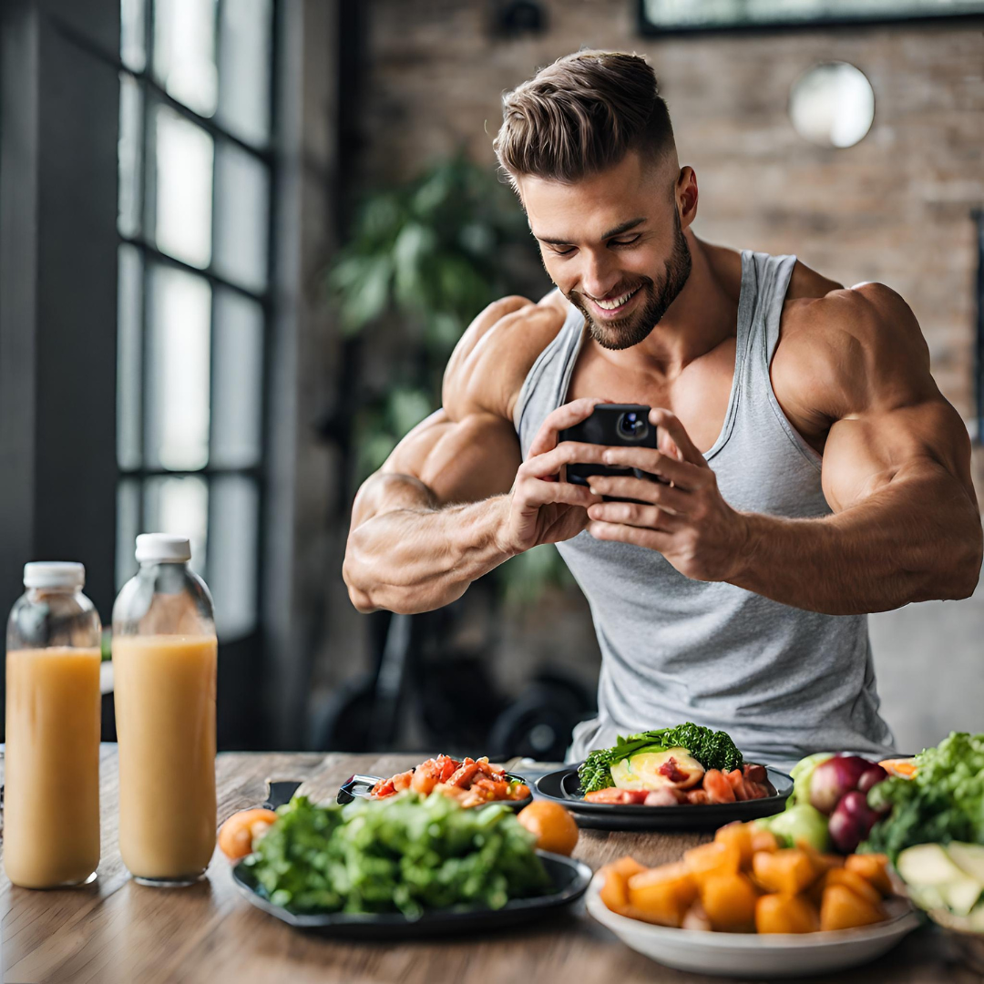

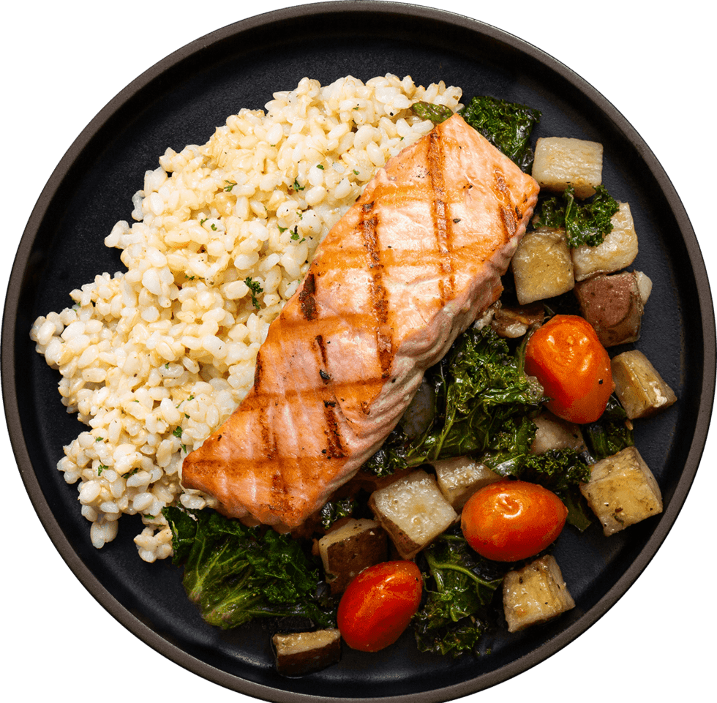
SnapNutrition, Food Logging and Tracking Made Better!
Take a picture of your food and instantly see the amount of calories, fat, protein, and carbs.
It even works with complex meals!
Calories
Fat (g)
Carbs (g)
Protein (g)
Total Mass (g)

Slide 3
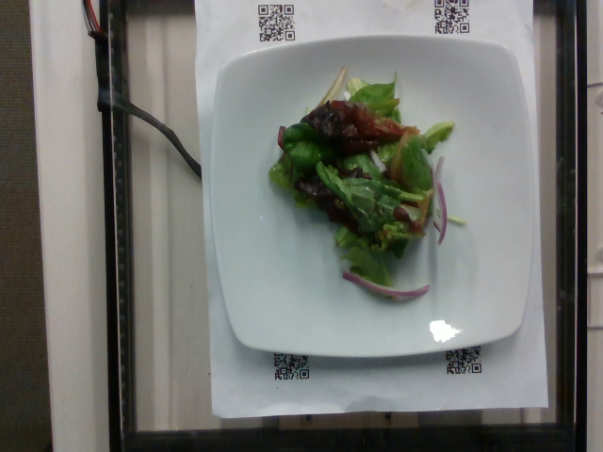
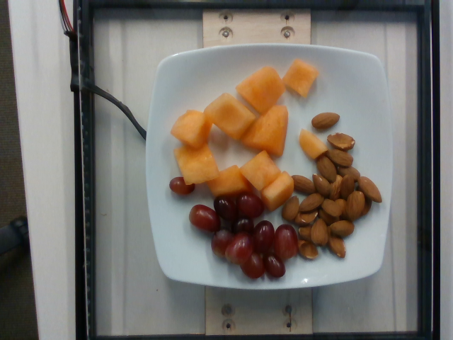
Data: Subset of Nutrition 5K Used to Train Predictive Models
Original Dataset Size: 180 GB → 2.2GB after preprocessing!!
Images: 3491 overhead pictures of single foods and complex meals
Labels: Calories, Total Mass(g), Fat (g), Carbs (g), Protein (g)
Multi-regression problem: (e.g. Predict Calories, Fat in Grams, etc.)
Examples
kCal | Mass (g) | Fat (g) | Carbs (g) | Protein (g)
6.44 | 23.0 | 0.092 | 1.219 | 0.506
kCal | Mass (g) | Fat (g) | Carbs (g) | Protein (g)
247 | 175 | 15.6 | 23.9 | 8.04
https://github.com/google-research-datasets/Nutrition5k
Notes:
Picture and Label, can explain is multi-regression problem
Talk about 180 GB (360 degree pan, lidar shots), down to ~2.2 GB

Slide 4
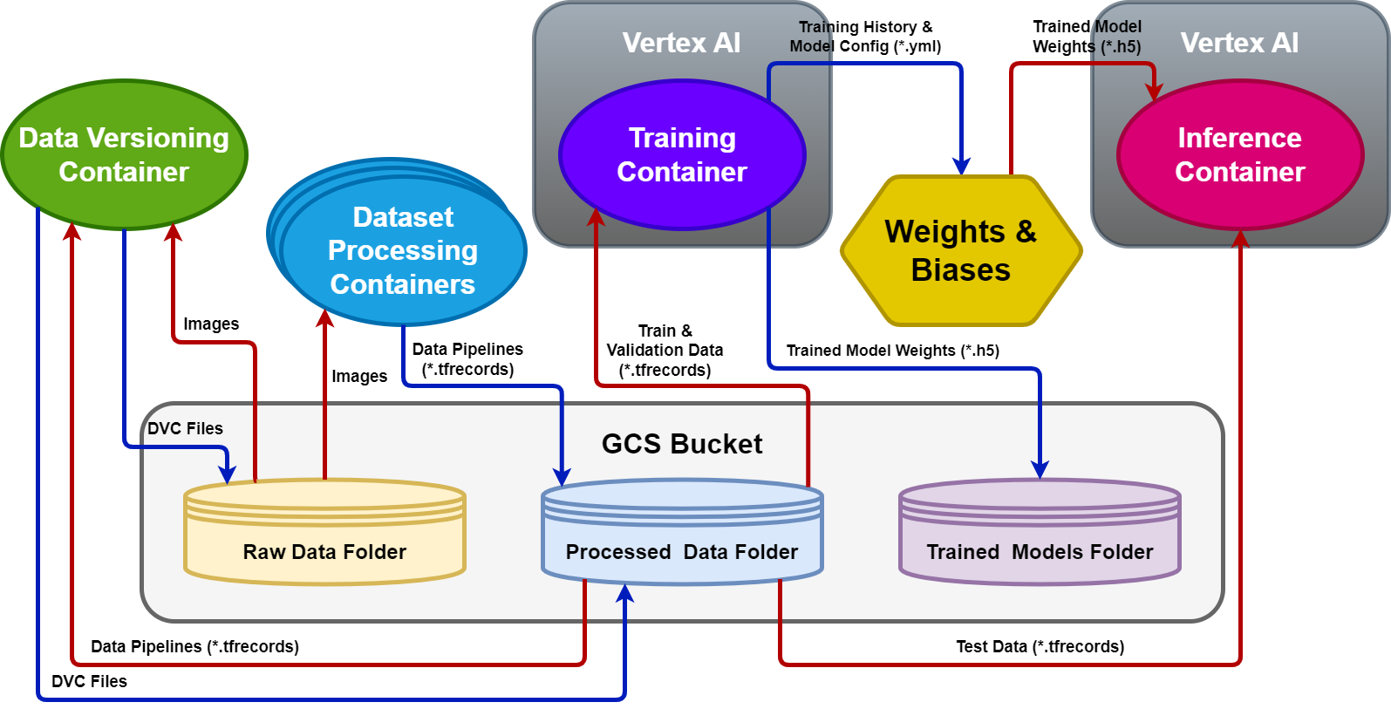
Overall Project Architecture

Slide 5
Overview of our pipeline
Data Flow
[DVC] Raw and processed data versions tracking
[Dask] Calculate image dataset metrics for normalization
[Luigi] Data augmentation
[TF Records] Created to compress train, validation, and test datasets splits
Modeling Flow
[Vertex AI Jobs Container] Custom jobs (2 GPU allocations currently)
Model config file and training architectures loaded into job package
Early stopping and fine-tuning used for transfer models
[Notebooks] Currently used to batch jobs for distillation/pruning/quantization
[Weights & Biases] used to track performance parameters and store models
Inference Flow
[Vertex, Kubeflow] Used to make inferences jobs after model selection task

Slide 6
Model Architecture, Hyperparameter Sweeps, Model Selection
Architectures
Simple VGG-like convolutional model as baseline
Transfer models using:
EfficientNet B7 and EfficientNet v2L
ResNet50 and InceptionResNetV2
VGG16 and VGG19
MobileNet v2
Xception
Hyperparameter Grid Search (using Weights & Biases sweep function)
Dask Normalization vs. ImageNet-Based Normalization
Learning rate [0.001-0.1]
Loss Function [MeanAbsoluteError, MeanSquaredError]
Current Best Transfer Learning Model
EfficientNet V2L
[Learning Rate: 0.1, Loss: MAE, Normalization: Dask Normalization]

Slide 7
Distillation, Compression, and Quantization
Transfer Learning Base: EfficientNetV2L
Model Name | Test Set Inference Time (min) | Mean Absolute Error | Before_Zip_Size (Kb) | After_Zip_Size (Kb)
Teacher Model | 0.0956 | 44.2532 | 608070.76 | 545952.613
Student (Base) | 0.0034 | 40.5333 | 89.816 | 66.442
Distilled Student | 0.0053 | 38.9059 | 89.816 | 66.212
Distilled Student Pruned | 0.0050 | 43.2508 | 89.816 | 66.13
TFLite Quantization
Inference Time Ratio is 0.8950 distill:quant
Compression Ratio is 3.3588x Smaller
Final size is 0.02029 Mb

Slide 8
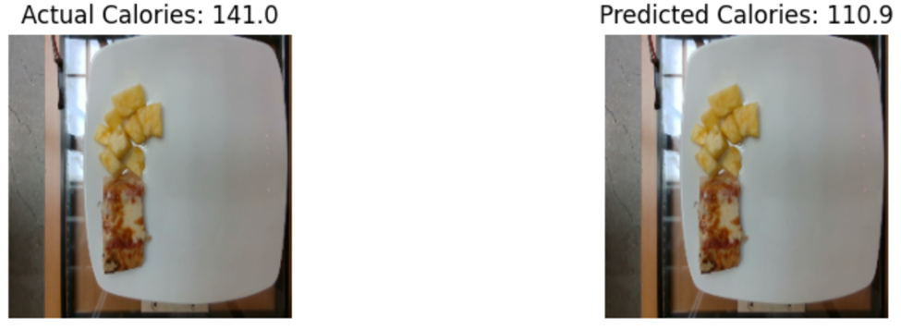
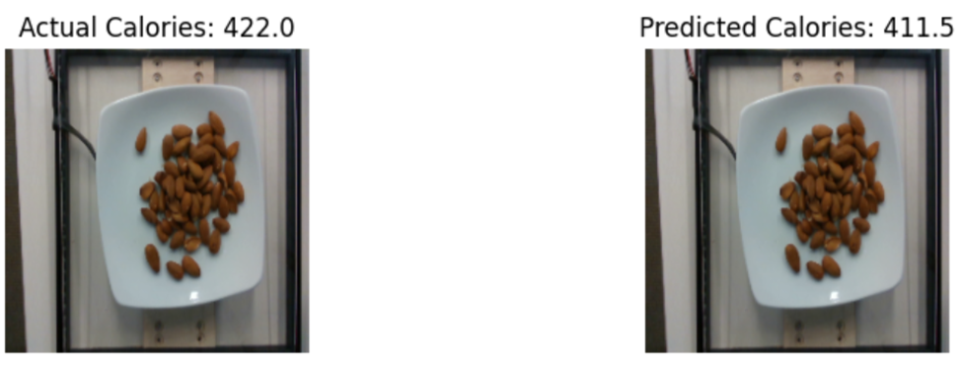
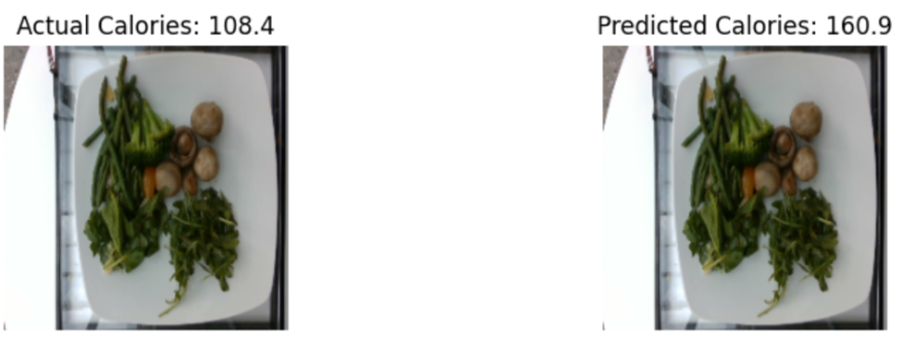
Sample Predictions
*Displaying calories only for brevity

Slide 9

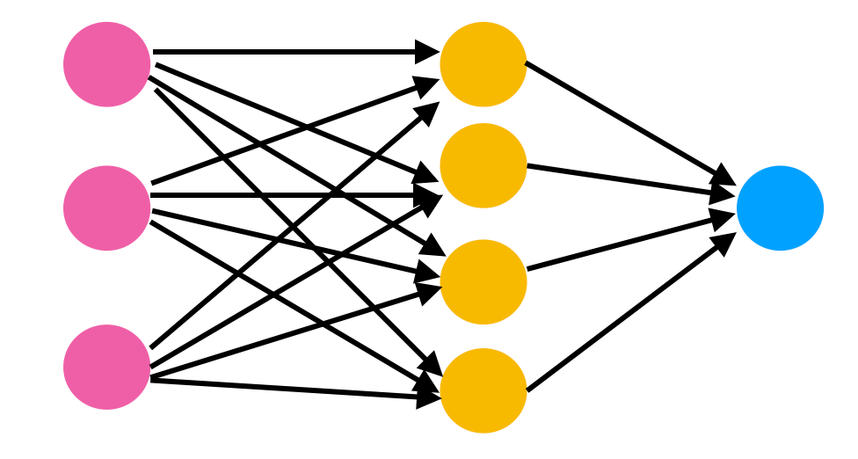




Next Steps
Incorporate model monitoring and model re-training triggers
Connect deployed model’s endpoint to frontend web UI
Implement a way for users to correct bad predictions and have feedback incorporated into new training sessions (e.g. augmenting off of images with bad predictions).
Model Monitoring/ Retraining Triggers
Connect Model to Web UI
Users Can Provide Feedback

